Slide 1
Hotel Management System

Slide 2
Project overview
Project Name: Hotel Management System.
Front End: Java swings, AWT.
Tool: Net Beans IDE.
Back End: Oracle.

Slide 3
Abstract
This project aims at creating Hotel Management system which is used by the hotel staff to record the data.
Users can check the availability of rooms.
The Users can register or log into the system.
The administrator will know the details of reservations.

Slide 4
Introduction to project
The Hotel Department maintains the room booking details in a certain Database.
It provides details of different rooms available.
Rooms with A.C, non A.C. which further classified into single, double and triple beds.
Room booking in Hotel can be of two types:
i. Current Booking.
ii. Advanced Booking.

Slide 5
Existing System
In the existing system, the person who wants to check the rooms available has to go through all the pages.
The existing system is manual system.
The Hotel Management System has to keep records of rooms manually.

Slide 6
Disadvantages of Existing System
It is time consuming process.
There is no survey of availability of rooms.
Paper work results in need of lot of space to keep the data.
Lack of security.
Chances of human errors.

Slide 7
Proposed System
To overcome the problems of manual system, Hotel Management System is proposed.
The Central objective of this system is to provide storage area for maintaining hotel details.
This software can manage and keep records of hotel.

Slide 8
Advantages of Proposed System
Saves time of users in quickly reserving rooms.
Very secure.
User friendly.
Ability to check any information at any point of time.
Can store complete information about hotel.

Slide 9
User Module
Can login with his/her own user id and password.
Check room availability.
Get facilities of hotel like meal.
Get information about reserved rooms(if room is already reserved).
Can cancel booking.

Slide 10
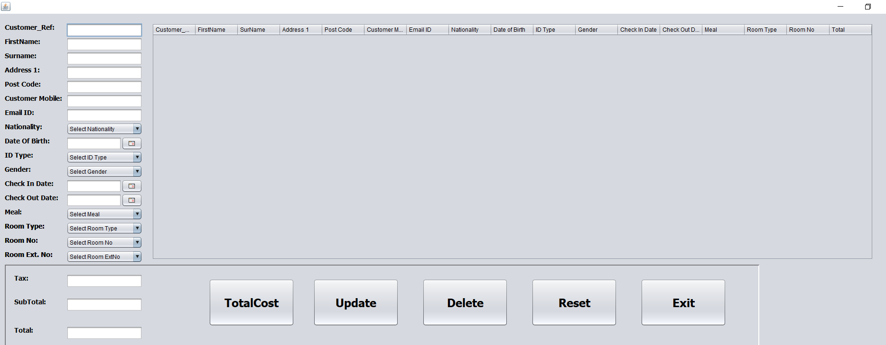
HOME PAGE

Slide 11
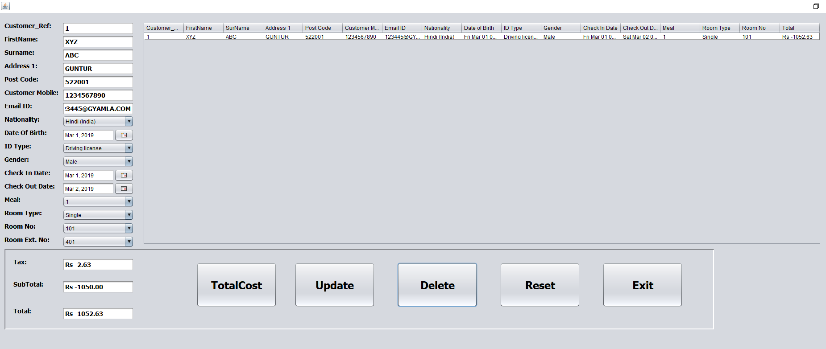
CALCULATING TOTAL COST

Slide 12
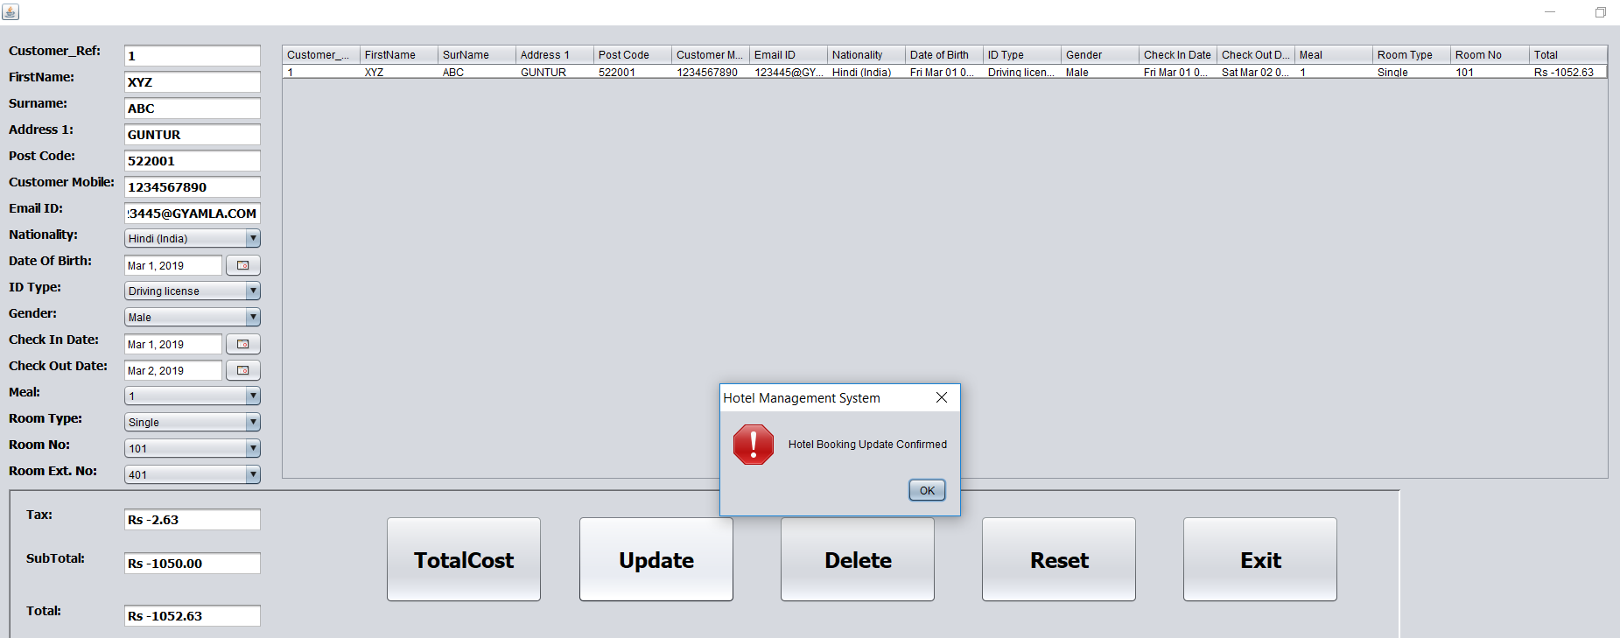
UPDATE BOOKING

Slide 13
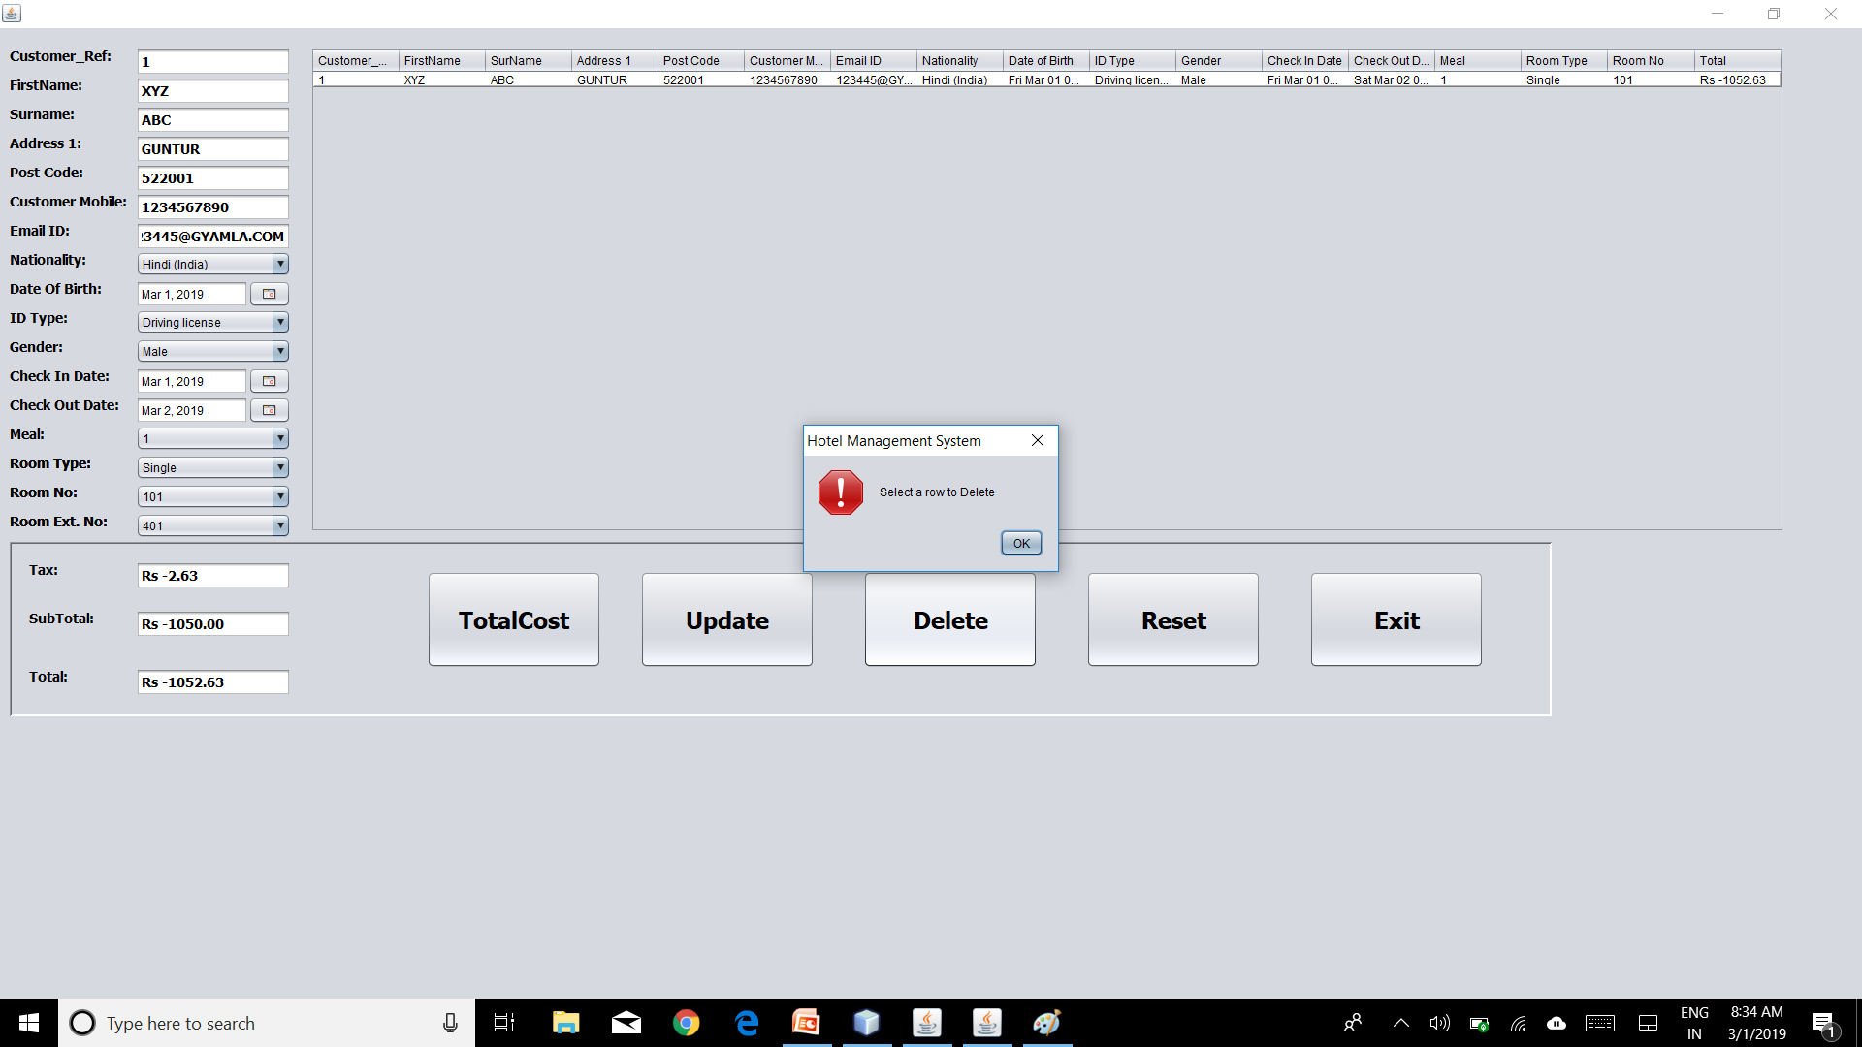
DELETE RECORD

Slide 14
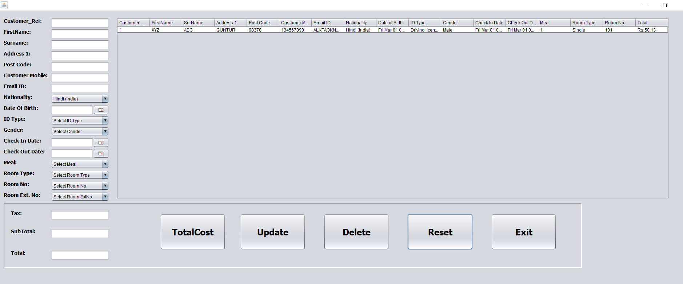
RESET

Slide 15
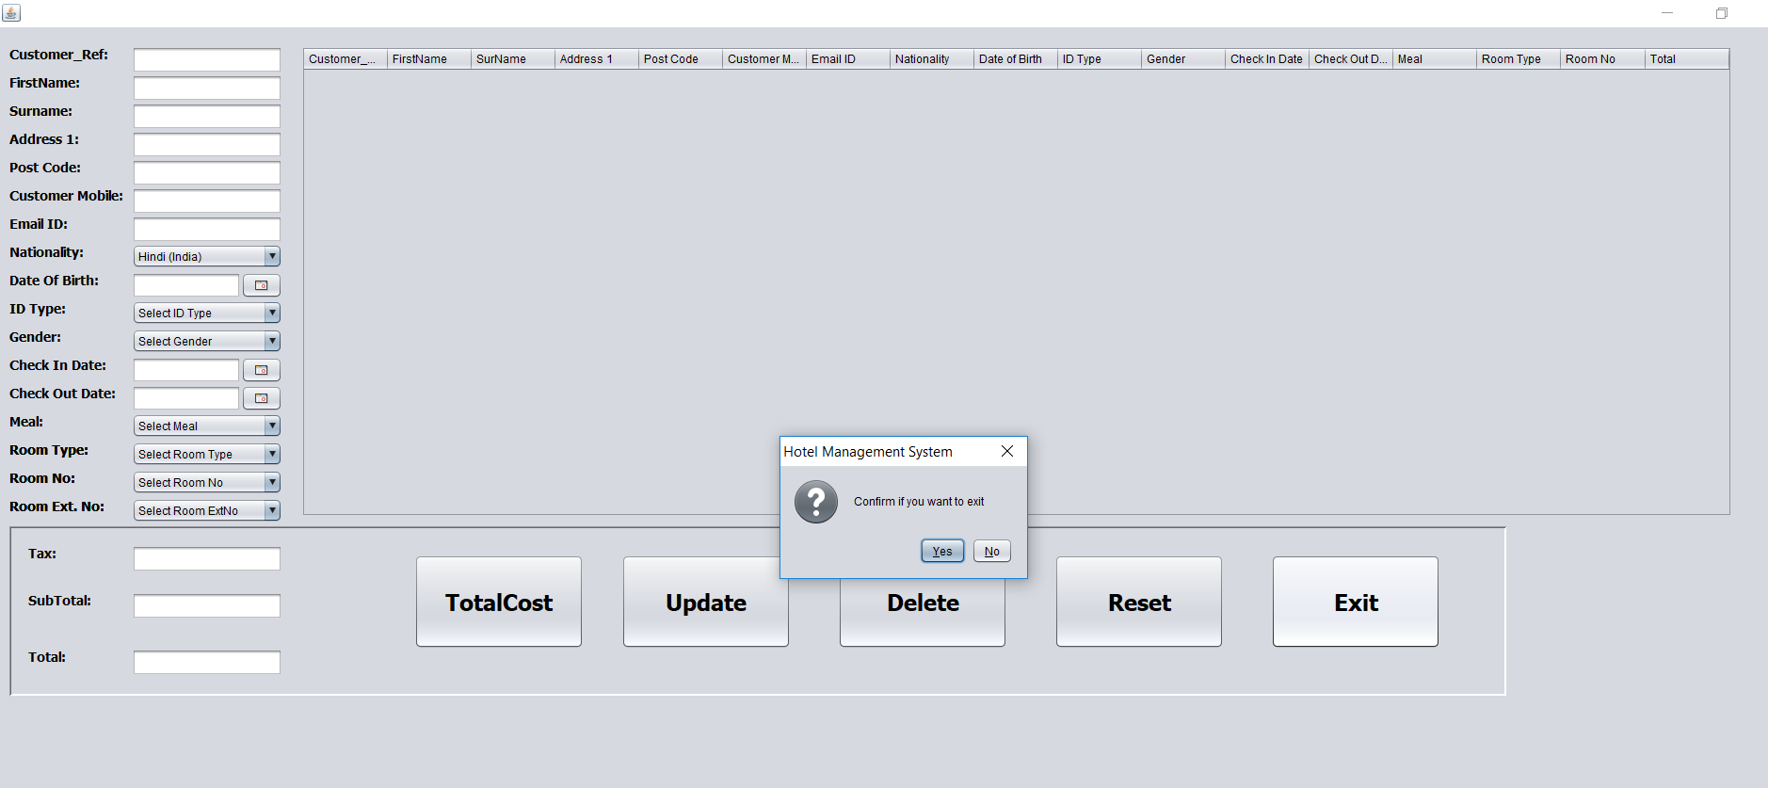
EXIT

Slide 16
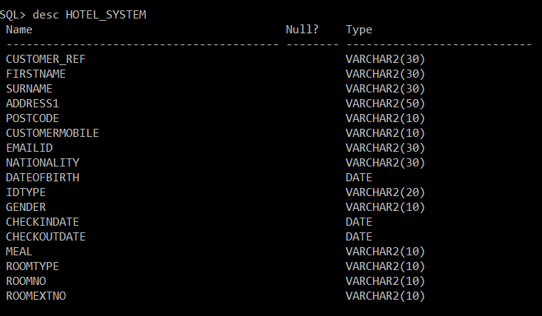
SQL TABLE

